Slide 1
IaC, Automation Testing ,Monitoring & Logging
- Ravi Kulkarni

Slide 2
PoinT Covered:
Infrastructure as Code : What & Why ?
CloudFormation : IaC Service provided by AWS
Automation Testing & its benefits
Logging and Monitoring in Cloud
CloudWatch: Logging and Monitoring service by AWS

Slide 3
What is IAC?
Infrastructure as Code (IaC) is the practice of managing and provisioning infrastructure through code.
This code can be used to automate the creation, deployment, and management of infrastructure.
IaC can help to improve the reliability, repeatability, and scalability of infrastructure.

Slide 4
Features of IaC
Reliability: IaC can help to improve the reliability of infrastructure by automating the creation and deployment of resources.
Repeatability: IaC can help to ensure that infrastructure is repeatable, which can be helpful for disaster recovery and testing.
Scalability: IaC can help to scale infrastructure easily, which can be helpful for growing businesses.
Cost savings: IaC can help you to save money on infrastructure costs. This is because IaC can help you to avoid overprovisioning resources and to optimize your infrastructure for efficiency.
Security: IaC can help to improve the security of infrastructure by providing a way to define security policies and controls.
Version control: IaC templates can be stored in version control systems, which makes it easy to track changes to your infrastructure and to revert to previous versions if necessary.

Slide 5
What is CloudFormation?
CloudFormation is an IaC service provided by AWS.
It allows you to define your infrastructure as a collection of resources and templates.
CloudFormation can then be used to create, update, and delete your infrastructure.

Slide 6
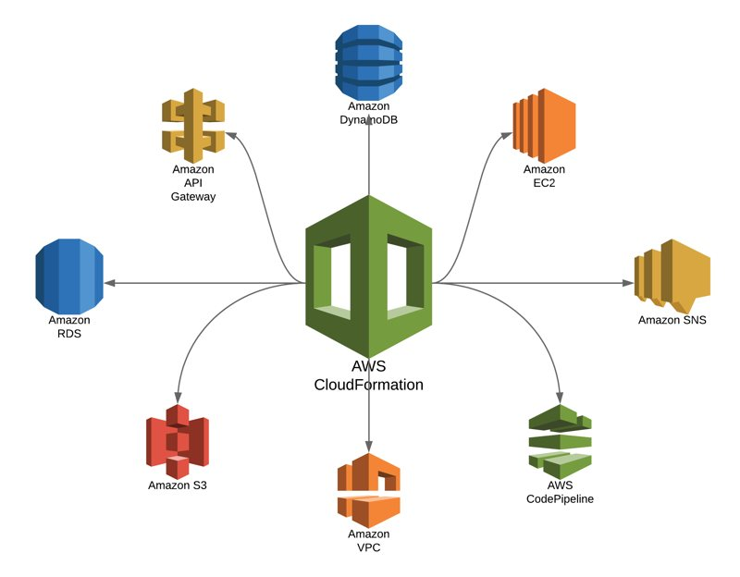

Slide 7
Features of CloudFormation
Template-based: CloudFormation templates are used to define your infrastructure. Templates are written in YAML or JSON and can be used to create a wide variety of AWS resources.
Consistent: CloudFormation ensures that your infrastructure is consistent by providing a way to define the relationships between resources. This makes it easy to manage your infrastructure and to troubleshoot problems.
Extensible: CloudFormation can be extended to support custom resources and custom logic. This makes it possible to automate even the most complex infrastructure deployments.
Secure: CloudFormation templates can be encrypted, which helps to protect your infrastructure from unauthorized access.
Auditable: CloudFormation provides a way to audit your infrastructure deployments. This makes it easy to track changes to your infrastructure and to ensure that your infrastructure is compliant with your security policies.

Slide 8
components of AWS CloudFormation
Templates: Templates are the blueprints for your infrastructure. They are written in JSON or YAML, and they describe the resources that you want to create, along with their properties and relationships.
Stacks: A stack is a collection of resources that are created and managed together. When you create a stack, CloudFormation creates all of the resources that are defined in the template.
Parameters: Parameters are variables that can be used in your templates. They allow you to customize the resources that are created, without having to modify the template itself.

Slide 9
components of AWS CloudFormation
Mappings: Mappings are a way to store data that can be used in your templates. They are typically used to store lists of values, such as regions or availability zones.
Conditions: Conditions are used to control the creation of resources based on certain criteria. For example, you could use a condition to only create a resource if a certain parameter is set to a specific value.
Outputs: Outputs are the values of properties of resources in your stack. They can be used to access the values of resources from other templates or applications.

Slide 10
What is automation testing?
Automation testing is the process of using software to execute tests automatically.
This can be done using a variety of tools and frameworks.
Automation testing can help to improve the efficiency and effectiveness of testing.

Slide 11
Benefits of automation testing
Increased efficiency: Automation testing can help to reduce the time and effort required to test software.
Improved accuracy: Automation testing can help to improve the accuracy of testing by reducing the risk of human error.
Increased coverage: Automation testing can help to increase the coverage of testing by automating tests that would be difficult or time-consuming to perform manually.
Reduced costs: Automation testing can help to reduce the costs of testing by reducing the need for manual testers.

Slide 12
Challenges of automation testing
Initial investment: Automation testing can require a significant initial investment in time and resources.
Maintenance: Automation tests must be maintained as the software changes.
Complexity: Automation testing can be complex to set up and maintain.
Skills: Automation testing requires specialized skills that may not be available in-house.

Slide 13
What is logging & Monitoring?
Logging is the process of recording events that occur in a system.
This information can be used to troubleshoot problems, analyze performance, and improve security.
Monitoring is the process of collecting and analyzing data about a system.
This information can be used to detect problems, identify trends, and optimize performance.

Slide 14
Why is logging and monitoring important?
Logging and monitoring are essential for maintaining the health and performance of a system.
They can help you to:
Troubleshoot problems
Analyze performance
Improve security
Detect unauthorized access
Identify trends
Optimize performance

Slide 15
Types of Logs
There are two main types of logs:
System logs: These logs record events that occur in the operating system.
Application logs: These logs record events that occur in applications.

Slide 16
What is CloudWatch?
loudWatch is a monitoring and management service that provides data and actionable insights for AWS cloud resources.
It collects metrics, logs, and events from AWS resources and other sources, and delivers them to users in a variety of ways.
CloudWatch can be used to monitor the health and performance of AWS resources, troubleshoot problems, and optimize the performance of applications.

Slide 17
Components of CloudWatch
Metrics: Metrics are measurements of the performance of your AWS resources.
Logs: Logs are records of events that occur in your AWS resources.
Events: Events are notifications of changes that occur in your AWS resources.
Dashboards: Dashboards are visual representations of your metrics, logs, and events.
Alarms: Alarms are notifications that are triggered when a metric exceeds a defined threshold.
Actions: Actions are automated tasks that are triggered by alarms.

Slide 18
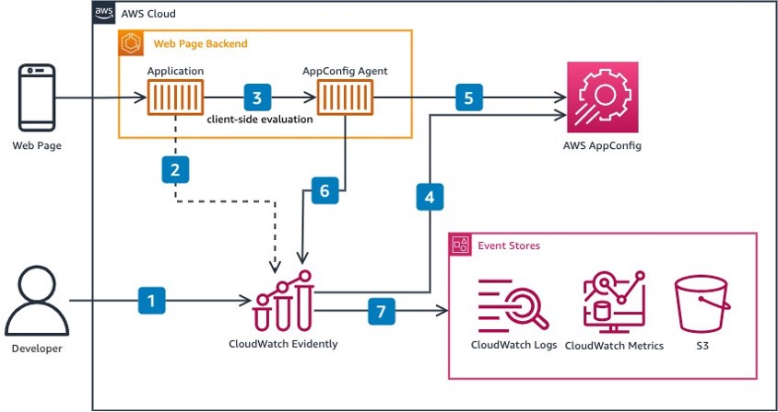

Slide 19
Refernces:
https://aws.amazon.com/blogs/architecture/introducing-client-side-evaluation-for-amazon-cloudwatch-evidently/
https://blog.shikisoft.com/11-reasons-to-use-aws-cloudformation-for-provisioning-your-architecture/

